Slide 1
Main Calls Procedures
Anthony Ramos

Slide 2
Type of Variables: Global Variables
Are defined in one file to be used across multiple files
int a; // a is a global variable
int main() {
…
}
int myFunc() {
…
}
Resource: tutorialspoint.com/

Slide 3
Type of Variables: Static Global Variables
Are defined with the purposes keeping the variable private to the file in which it was defined (i.e. can’t link a static global var in another C program).
static int a; // a is a static global variable
int main() {
…
}
int myFunc() {
…
}

Slide 4
Types of Variables: Local Variables
Resource: programiz.com

Slide 5
Types of Variables: Static Local Variables
Are defined as PRIVATE variable only for use within the function it is defined.
int main() {
static int i;
}
int myFunc() {
static int j = -2;
}

Slide 6
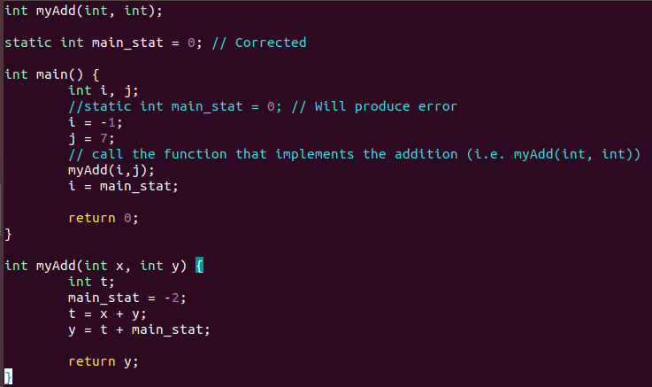
Example 1+2
Q: What is the value of i after myAdd()?
A: i = -2

Slide 7
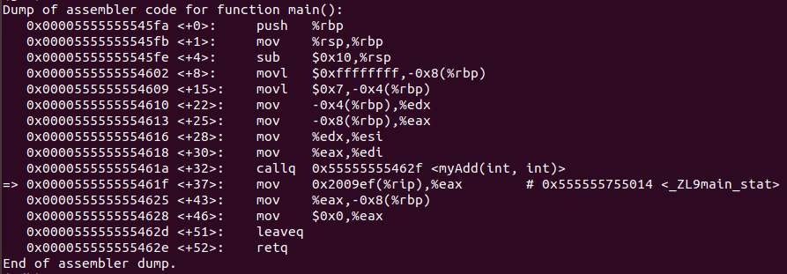
Example 1+2
-2 (Little Endian)

Slide 8
Example 1+2
The static variable main_stat is shared between main() and myAdd(). It was initially initialized to 0, then modified in function myAdd()to -2, upon returning to main(), main_stat is still -2 and so i = -2.

Slide 9
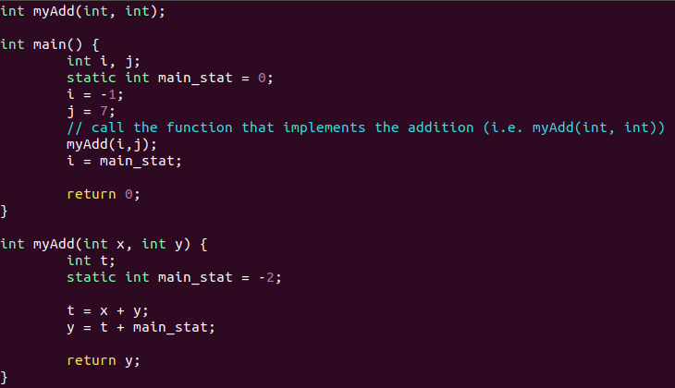
Example 3
Q: What is the value of i after myAdd()?
A: i = 0

Slide 10
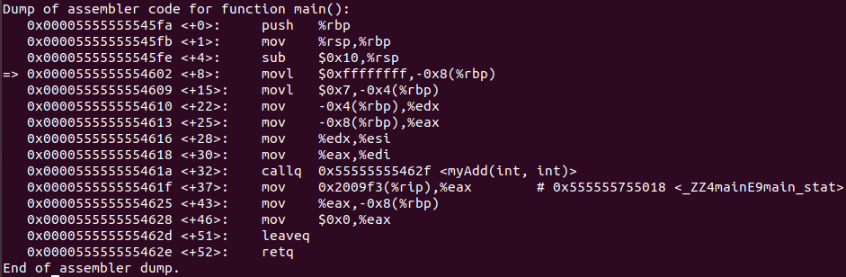
Example 3
-2
0

Slide 11
Example 3
Now, main_stat is a private variable within their respective function scopes. That is, despite having the same variable name, they are two different variables initialized to two different values. So, the value of i after the myAdd()function call is the value of main_stat initialized in main(). That is, i = 0.

Slide 12
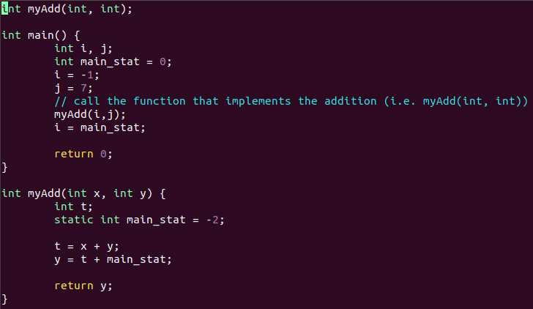
Example 4
Q: What is the value of i after myAdd()?
A: i = 0

Slide 13
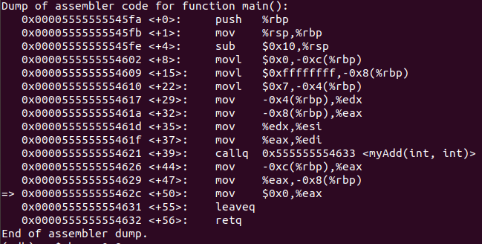

Example 4

Slide 14
Example 4
There are two instances of main_stat: one local and one static but like in the previous example, main() sees only the local instance of main_stat and has no knowledge of static main_stat. Thus, the value of i after the myAdd()function call is the value of main_stat initialized in main(). That is, i = 0.

Slide 15
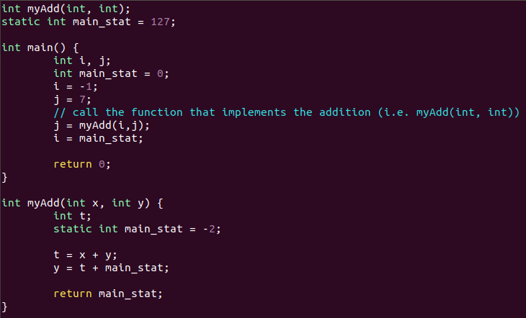
Example 5
Q: What is the value of i,j,main_stat after myAdd()?
A: i = 0; j = -2; main_stat = 0

Slide 16
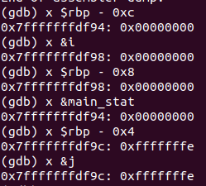
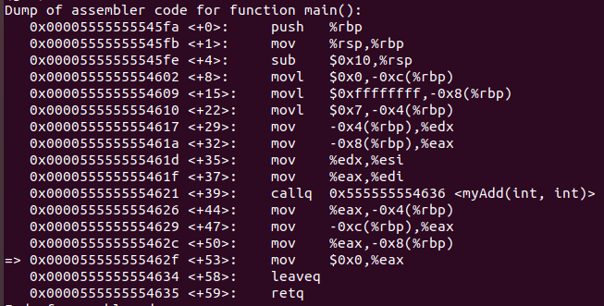
Example 5
i
main_stat
j

Slide 17
Example 5
There are three instances of main_stat initialized in this program. One static declared outside (i.e. global) the main() and myAdd() , one local within main(), and another static within myAdd(). However, as previously mentioned, these variable exist only within the scopes of their respective functions. That also means, that the global static variable main_stat is not seen by main() or myAdd(). In other words, it is “SHADOWED” by the other instances of main_stat . Thus, the value of i after the myAdd()function call is the value of main_stat initialized in main(). That is, i = 0. The value of j is the value of main_stat initialized in myAdd()since it is returned back to main(). So, j = -2 .

Slide 18
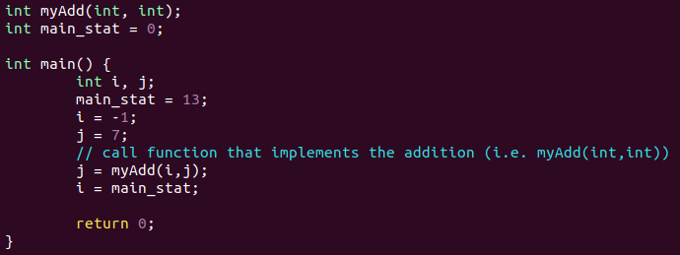
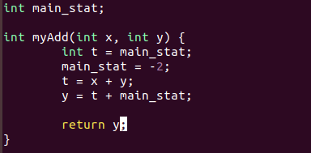
Example 6
Q: What is the value of i,j after myAdd()?
A: i = -2 ;j = 4
two .cpp files!

Slide 19

Example 6 – Linker Error
Linking Error!

Slide 20
Example 6 – Linker Error
Must resolve this!

Slide 21
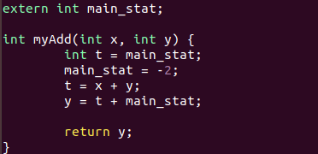
Example 6 (Corrected)
The objective is to keep main_stat as a shared variable. To do this, we make use of extern command. Specifically, we must change myAdd.cpp to the following:

Slide 22
Note on Extern
The extern command declares a variable without allocating memory (i.e., without defining it). It does so by assuming that the variable will be defined somewhere else.
Note that if you were to write Extern int a = 5, you would get an error because this is essentially a contradiction.

Slide 23
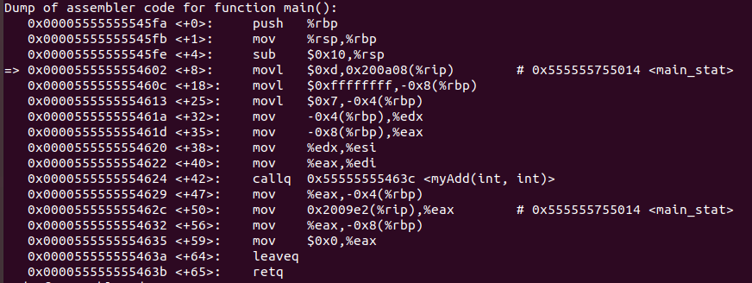

Example 6
i
j

Slide 24
Example 6
The value of i is equal to main_stat which was initially initialized to 0, then set to 13 in main() and modified again in myAdd()to -2. Upon returning to main(), main_stat is still -2. Thus, i = -2.
The value of j is determined by first computing t = x + y where x = i and y = j. Variables i and j were passed to the function myAdd() . Since i = -1 , j = 7 ,then t = -1 + 7 = 6. Next, y = t + main_stat is computed where main_stat = -2 . So, y = 6 + -2 = 4.Variable y is returned, so the assignment of j = myAdd(-1,7) in main() yields 4 (i.e. j = 4) .

Slide 25
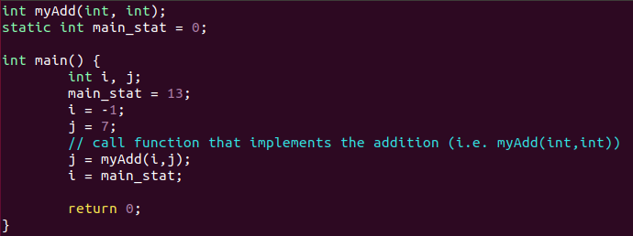
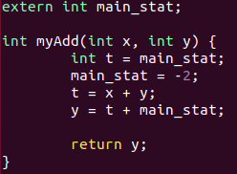
Example 7
two .cpp files!

Slide 26
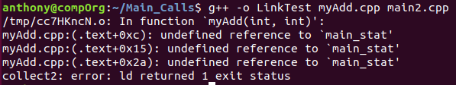
Example 7 – Linker Error
We cannot compile this because the linker cannot “see” the STATIC global variable main_stat. The way we defined it in main2.cpp, makes it PRIVATE and thus invisible to myAdd.cpp and memory has not been allocated for this variable in MyAdd.cpp.

Slide 27
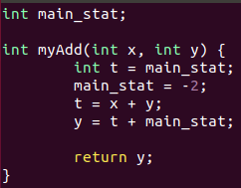
Example 7 - Corrected
We must remove the extern command so that memory can be allocated. Note that main_stat is no longer shared across the two cpp files. However, if we wanted to keep main_stat as a shared variable, we must remove the static keyword from main2.cpp (see Ex 6).
Extern removed

